Slide 1


Slide 2
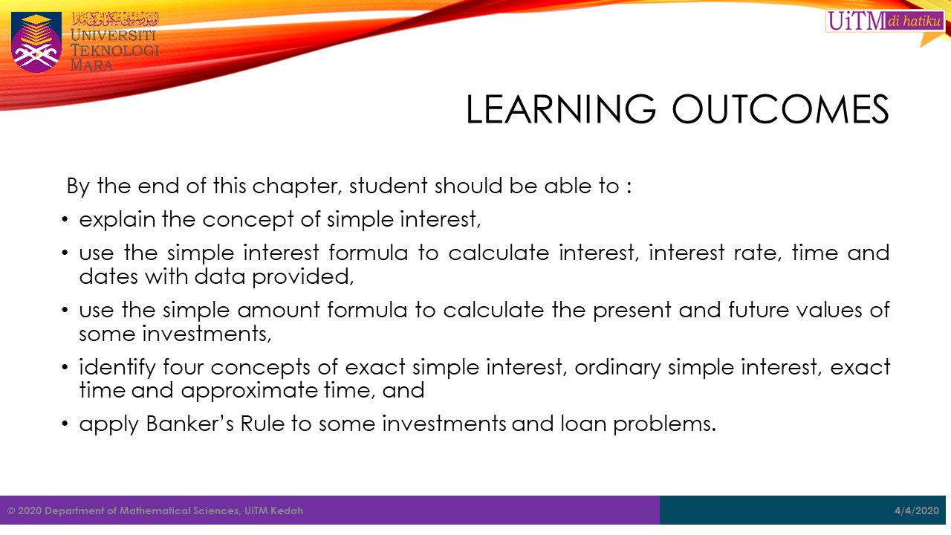

Slide 3


Slide 4

What Is Islamic Banking?
KEY TAKEAWAYS
Islamic banking, also referred to as Islamic finance or shariah-compliant finance, refers to finance or banking activities that adhere to shariah (Islamic law).
Two fundamental principles of Islamic banking are the sharing of profit and loss, and the prohibition of the collection and payment of interest by lenders and investors.
Islamic banks make a profit through equity participation, which requires a borrower to give the bank a share in their profits rather than paying interest.
Some conventional banks have windows or sections that provide designated Islamic banking services to their customers.

Slide 5
Major Differences Between Islamic and Conventional Banking
Conventional Banking | Islamic Banking
Money is a product besides medium of exchange and store of value | Real Asset is a product Money is just a medium of exchange
Time value is the basis for charging interest on capital | Profit on exchange of goods & services is the basis for earning profit
The expanded money in the money market without backing the real assets, result deficit financing | Balance budget is the outcome of no expansion of money
Interest is charged even in case; the organization suffers losses. Thus, no concept of sharing loss | Loss is shared when the organization suffers loss
While disbursing cash finance, running finance, or working capital finance, no agreement for exchange of goods & services is made | The execution of agreement for the exchange of good & services is must, while disbursing funds under Salam & Istisna contracts
Due to non-existence of goods & services behind the money while disbursing funds, the expansion of money takes place, which creates inflation | Due to existence of goods & services no expansion of money takes place and thus no inflation is created
Due to inflation the entrepreneur increases prices of his goods & services, due to incorporating inflationary effect into cost of product | Due to control over inflation, no extra price is charged by the entrepreneur
Bridge financing and long-term loans lending is not made on the basis of existence of capital goods | Musharakah & Diminishing Musharakah agreements are made after making sure the existence of capital goods before disbursing funds for a capital project

Slide 6
Major Differences Between Islamic and Conventional Banking
Conventional Banking | Islamic Banking
Real growth of wealth does not take place, as the money remains in few hands | Real growth in the wealth of the people of the society takes place, due to multiplier effect and real wealth goes into the ownership of lot of hands
Due to failure of the projects the loan is written off as it becomes non-performing loan | Due to failure of the project, the management of the organization can be taken over to hand over to a better management
Debt’s financing gets the advantage of leverage for an enterprise, due to interest expense as deductible items form taxable profit | Sharing profits in case of Mudarabah and sharing in the organization of business venture in case of Musharakah, provides extra tax to federal Government. This leads to minimize the tax burden over salaried persons.
In leasing ownership has been transferred and start and the risk and reward bear by the client. | In Islamic banking leasing, ownership remains with bank and risk and reward bear by the bank as owner of asset.
In conventional banking, fixed rate of interest being given to depositors. | In Islamic banking, profit are distributed out of profit earning by bank for the month as per decided weightages.

Slide 7


Slide 8


Slide 9


Slide 10


Slide 11


Slide 12


Slide 13
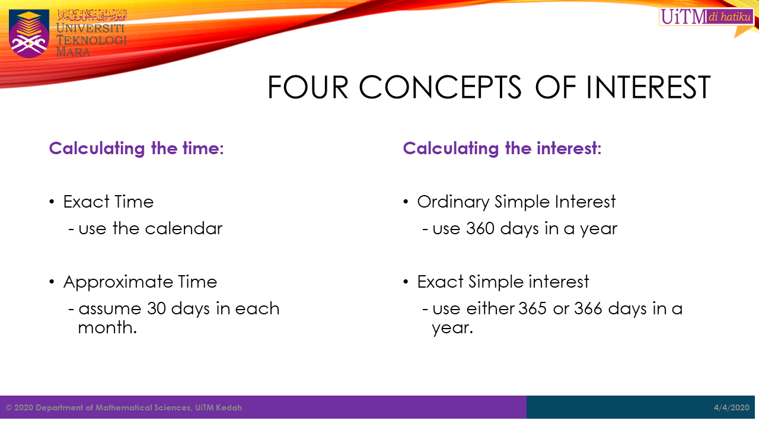

Slide 14


Slide 15


Slide 16


Slide 17
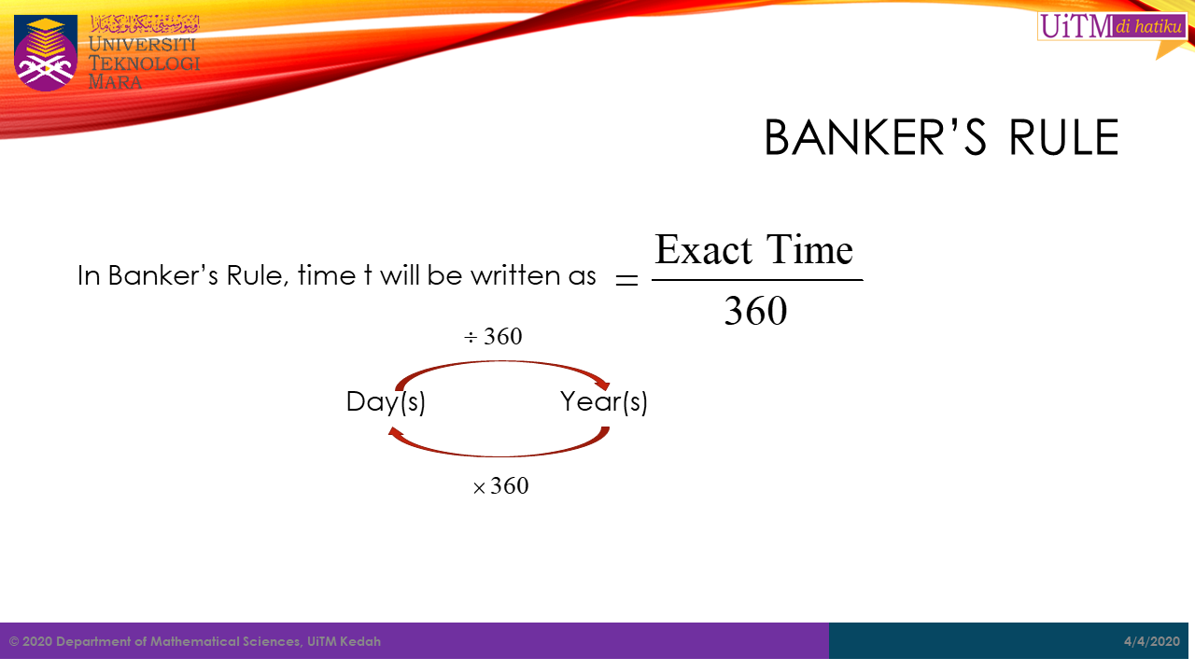

Slide 18


Slide 19


Slide 20
